Slide 1
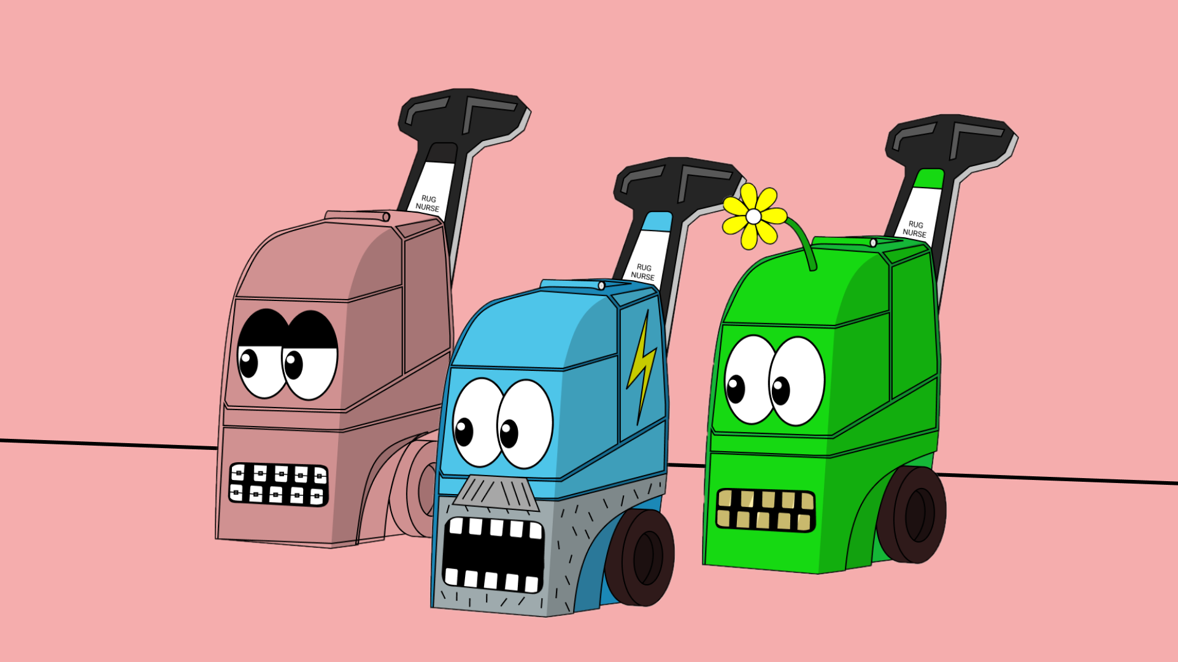
Setup holder status (Collab.Land)
1-5 Nurse (1 vote)
6-10 Doctor (5 votes)
10+ Surgeon (20 votes)
Drop collection:
Early bird – free
Public sale – 0.02 ETH
Marketing – grow hype & community
Vote on first collection to sweep (could be your own – nice!)
Decide what we list, when & how much!
SWEEEEEEEEP
Vote on how much to re-invest for next sweep/project.
Split profits among holders.
Profit / 3456 x #nfts = dividends
RINSE & REPEAT

Slide 2
CONTROL THE FLOOR
456 Rug Surgeons NFTs will be minted for FREE.
Remaining 3,000 sold for 0.02 ETH (60ETH traded)
To hit 100ETH Traded (to verify on OpenSea), the team will sweep.
FLOOR SWEEP
We will sweep the floor – 1 ETH worth, every month. BUT we will only sweep Rug Surgeons listed at 0.05 ETH or higher.

